Slide 1
Link

Slide 2
Outline
Symbol Resolution
Executable Object Files
Loading
Dynamic Linking
Position Independent Code (PIC)
Suggested reading: 7.8~7.12

Slide 3
Packaging commonly used functions
How to package functions commonly used by programmers?
  math, I/O, memory management, string manipulation, etc.

Slide 4
Packaging commonly used functions
Awkward, given the linker framework so far:
  Option 1: Put all functions in a single source file
    programmers link big object file into their programs
    space and time inefficient
  Option 2: Put each function in a separate source file
    programmers explicitly link appropriate binaries into their programs
    more efficient, but burdensome on the programmer

Slide 5
Packaging commonly used functions
Solution: static libraries (.a archive files)
  concatenate related relocatable object files into a single file with an index (called an archive)
  enhance linker so that it tries to resolve unresolved external references by looking for the symbols in one or more archives
  If an archive member file resolves reference, link into executable

Slide 6
Static libraries (archives)
p1.c
p2.c
Translator
Translator
p1.o
p2.o
libc.a
static library (archive) of relocatable object files concatenated into one file.
Linker (ld)
executable object file (only contains code and data for libc functions that are called from p1.c and p2.c)
p
Further improves modularity and efficiency by packaging commonly used functions (e.g., C standard library, math library)
Linker selectively only the .o files in the archive that are actually needed by the program.

Slide 7
Creating static libraries
atoi.c
printf.c
random.c
Translator
Translator
...
Translator
atoi.o
printf.o
random.o
Archiver (ar)
libc.a
C standard library
Archiver allows incremental updates:
  recompile function that changes and replace .o file in archive.
ar rs libc.a atoi.o printf.o … random.o

Slide 8
Using static libraries
E:
  relocatable object files that will be merged to form the executable
U:
  Unresolved symbols
D:
  Symbols that have been defined in previous input files
Initially all are empty

Slide 9
Using static libraries
Scan .o files and .a files in the command line order.
When scan an object file f,
  Add f to E
  Updates U, D
When scan an archive file f,
  Resolve U
  If m is used to resolve symbol, m is added to E
  Update U, D using m

Slide 10
Using static libraries
If any entries in the unresolved list at end of scan, then error
Problem:
  command line order matters!
  Moral: put libraries at the end of the command line.

Slide 11
ELF object file format
ELF header
Segment header table
.init section
.text section
.rodata section
.data section
.bss section
.symtab
.debug
.line
.strtab
Section header table

Slide 12
Executable Object Files
ELF header
  Overall information
  Entry point
.init section
  A small function _init
  Initialization
Segment header table
  page size, virtual addresses for memory segments (sections), segment sizes.

Slide 13
.init section
Startup code
  At the _start address defined in the crt1.o
  Same for all C program
0x080480c0<_start>:
call _libc_init_first
call _init
call atexit
call main
call _exit

Slide 14
Loading
Unix> ./p
Loader
  Memory-resident operating system code
  Invoked by call the execve function
  Copy the code and data in the executable object file from disk into memory
  Jump to the entry point
  Run the program

Slide 15
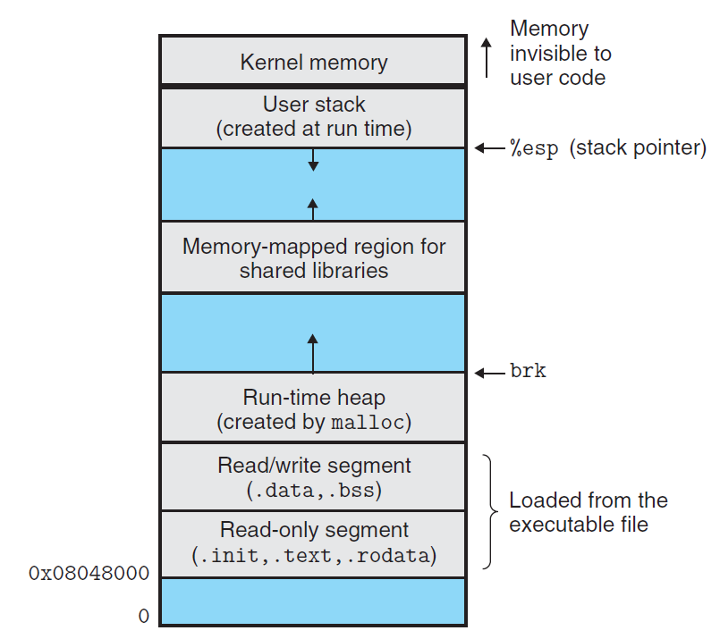

Slide 16
Loading
Read only data segment
LOAD off 0x00000000 vaddr 0x08048000
paddr 0x08048000 align 2**12
filesz 0x00000448 memsz 0x00000448 flags r-x
Read/write data segment
LOAD off 0x00000448 vaddr 0x08049448
paddr 0x08049448 align 2**12
filesz 0x000000e8 memsz 0x00000104 flags rw

Slide 17
Example (1/3)
(a) addvec.o
void addvec(int *x, int *y, int *z, int n)
{
int i;
for (i = 0; i < n; i++)
z[i] = x[i] + y[i];
}

Slide 18
Example (2/3)
(b) multvec.o
void multvec(int *x, int *y,
int *z, int n)
{
int i;
for (i = 0; i < n; i++)
z[i] = x[i] * y[i];
}
unix> gcc -c addvec.c multvec.c
unix> ar rcs libvector.a addvec.o multvec.o

Slide 19
Example (3/3)
/* main2.c */
#include <stdio.h>
#include "vector.h“
int x[2] = {1, 2};
int y[2] = {3, 4};
int z[2];
int main()
{
addvec(x, y, z, 2);
printf("z = [%d %d]\n", z[0], z[1]);
return 0;
}

Slide 20
Static Linked Libraries
main2.c
vector.h
Translators
(cc1, as)
libvector.a
libc.a
printf.o and any other modules called by printf.o
Addvec.o
main2.o
Linker (ld)
p2
Fully linked executable in memory
unix> gcc -O2 -c main2.c
unix> gcc -static -o p2 main2.o ./libvector.a

Slide 21
Disadvantages of Static Libraries
Minor bug fixes of system libraries require each application to explicitly relink
Duplicate lots of common code in the executable files
  e.g., every C program needs the standard C library
Duplicate lots of code in the memory

Slide 22
Shared Libraries
Synonym
  Shared object on Linux, denoted by .so suffix
  DLL (dynamic link libraries) on Windows
What sharing means
  Only one .so file for a particular library
  Code and data in the .so file are shared by all of the executable object files that reference the library

Slide 23
Shared Libraries
Generate the shared libraries
  Unix> gcc –shared –fPIC –o libvector.so addvec.c multvec.c
  –shared: creating a shared object
  –fPIC: creating the position independent code
Partially link with shared libraries
  Unix>gcc –o p2 main2.c ./libvector.so

Slide 24
Partially Linking
main2.c
vector.h
Translators
(cc1, as)
libc.so
Libvector.so
main2.o
Relocation and symbol table info
Linker (ld)
Partially linked executable object code file
p2

Slide 25
Partially Linking
Which parts in libvector.so are copied into p2
  The code and data sections No
  Relocation and symbol table information Some

Slide 26
Dynamically linking
p2
Partially linked executable object code file
libc.so Libvector.so
Loader(execve)
Code and data
Dynamic Linker(ld-linux.so)
Fully linked executable in memory

Slide 27
Dynamically linking
Done by execve() & ld-linux.so
  Copy code and data of libc.so and libvector.so into to memory segment
  Relocate any references in p2 to symbols defined by libc.so and libvector.so
The pathname of the ld-linux.so is contained in the .interp section of p2
After linking, the locations of the shared libraries are fixed and do not change during the execution time

Slide 28
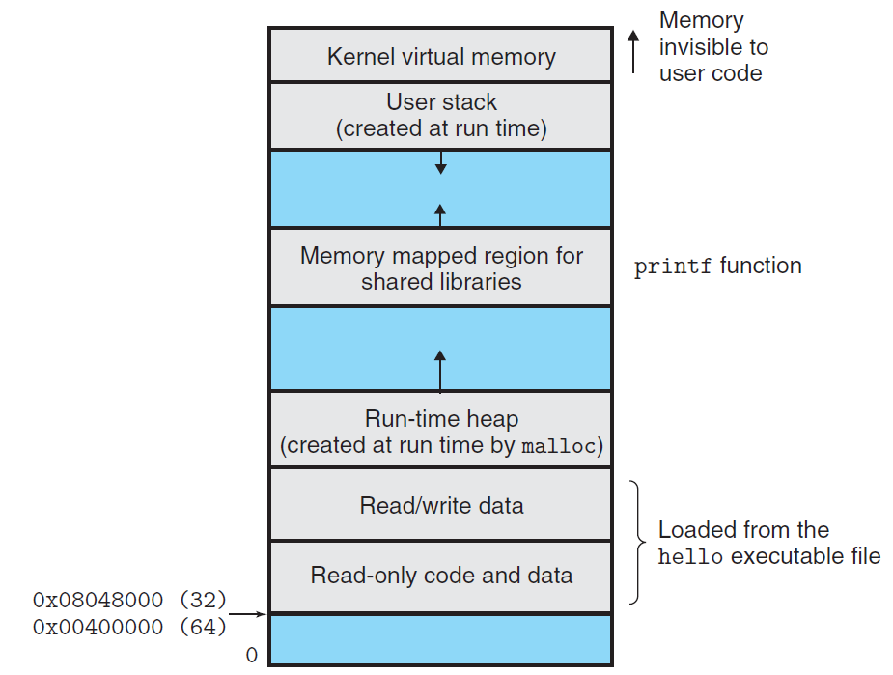
Memory mapped region for shared libraries

Slide 29
Position-Independent Code (PIC)
Allow multiple running processes to share the same library code
  Save precious memory resource
Naïve: assign a dedicated address
  Inefficient use of the address space
  Difficult to manage
Better: load and execute at any address
  Position-independent code (PIC)
  gcc with -fPIC

Slide 30
Position-Independent Code (PIC)
Position-Independent Code (PIC)
  Internally-defined procedures (OK)
    PC-relative reference
  Externally-defined procedures and reference to global variable (NO)
    Indirect reference
    Global offset table (GOT)
      Private
      At the beginning of .data

Slide 31
Position-Independent Code (PIC)
PIC Data References
call L1
L1: popl %ebx
addl $VAROFF, $ebx
movl (%ebx), %eax
movl (%eax), %eax
  Performance disadvantages (5 instr)
  An additional memory reference to the GOT
  An additional register to hold GOT entry

Slide 32
Position-Independent Code (PIC)
PIC Function Calls
call L1
L1: popl %ebx
addl $PROCOFF, $ebx
call *(%ebx)
  Performance disadvantages (4 instr)
  Optimization: lazy binding

Slide 33
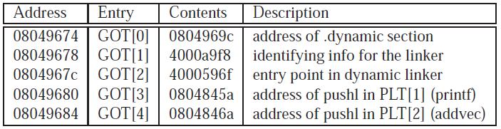
Position-Independent Code (PIC)
Lazy Binding
  Global Offset Table (GOT)
    .data
  Procedure Linkage Table (PLT)
    .text

Slide 34
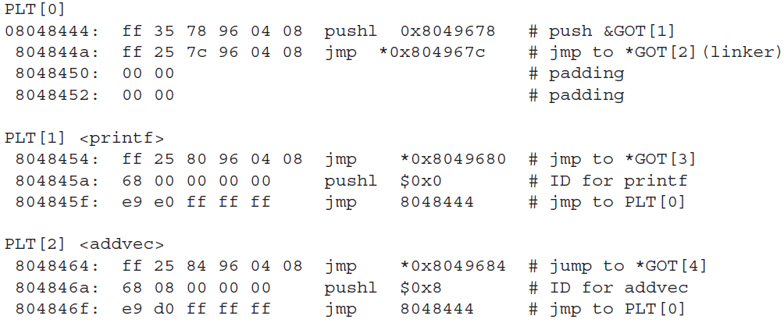
Position-Independent Code (PIC)
PLT
Call addvec
1

Slide 35
Position-Independent Code (PIC)
PLT
Call addvec
2
1

Slide 36
Position-Independent Code (PIC)
PLT
Call addvec
2
3
1

Slide 37
Position-Independent Code (PIC)
PLT
Call addvec
4
2
3
1

Slide 38
Position-Independent Code (PIC)
PLT
Call addvec
4
5

Slide 39
Position-Independent Code (PIC)
PLT
Call addvec
4
5
6

Slide 40
Position-Independent Code (PIC)
PLT
Call addvec
7
6

Slide 41
Position-Independent Code (PIC)
PLT
Call addvec
8

Slide 42
Position-Independent Code (PIC)
PLT
Call addvec
9
xxxxxxx

Slide 43
Linking at Running Time
Loading and Linking Shared Libraries from Applications
  Done explicitly by user with dlopen() in Linux
Unix>gcc –rdynamic –O2 –o p3 dll.c -ldl

Slide 44
Linking at Running Time
#include <dlfcn.h>
void *dlopen(const char *filename, int flag) ;
returns: ptr to handle if OK, NULL on error
void *dlsym(void *handle, char *symbol) ;
returns: ptr to symbol if OK, NULL on error
int dlclose(void *handle) ;
returns: 0 if OK, -1 on error
const char dlerror(void) ;
returns: errormsg if previous call to
dlopen, dlysym, or dlclose failed,
NULL if previous call was OK

Slide 45
#include <stdio.h>
#include <dlfcn.h>
int x[2] = { 1, 2} ;
int y[2] = { 3, 4} ;
int z[2];
int main()
{
void *handle;
void (*addvec)(int *, int *, int *, int ) ;
char *error ;

Slide 46
/*dynamically load the shared library that contains addvec() */
handle = dlopen(“./libvector.so”, RTLD_LAZY) ;
if (!handle) {
fprintf(stderr, “%s\n”, dlerror()) ;
exit() ;
}
/*get a pointer to the addvec() function we just loaded */
addvec = dlsym(handle, “addvec”) ;
if ( (error = dlerror()) != NULL ) {
fprintf(stderr, “%s\n”, error) ;
exit(1) ;
}

Slide 47
/* Now we can call addvec() just like any other function */
addvec(x, y, z, 2)
printf(“z=[%d, %d]\n”, z[0], z[1]) ;
/* unload the shared library */
if (dlclose(handle) <0) {
fprintf(stderr, “%s\n”, dlerror()) ;
exit(1) ;
}
return 0 ;
}

